Slide 1
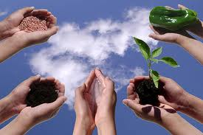
The Seeds of Global Civilization
AG 101: Ag & The Modern World

Slide 2
“The first farmer was the first man. All historic nobility rests on the possession and use of land.”
“The discovery of Agriculture was the first big step toward a civilized life.”
- Arthur Keith
- Ralph Waldo Emerson

Slide 3
Agriculture is…
the science, art, or practice of cultivating the soil, producing crops, and raising livestock and in varying degrees the preparation and marketing of the resulting products.

Slide 4
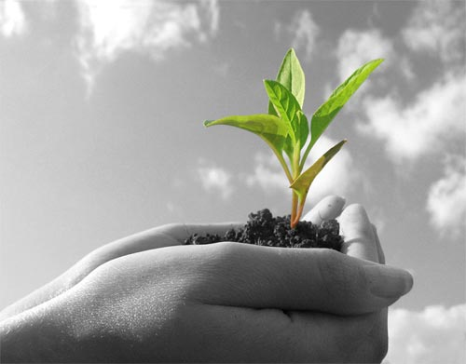
10,000 B.C. = Beginnings of Agriculture
End of Ice Age
  World became warmer and wetter
  Climate Stabilized
  CO2 levels increased
    = increased plant productivity
  Increase in Human Intelligence
These factors helped make agriculture possible at this point in time.

Slide 5
10,000 B.C.
Hunter/Gatherer Societies
The Fertile Crescent
  SW Asia (present day Iraq/Iran)
  “Abu Hureyra” tribe = The world’s FIRST farmers
    Oldest evidence of agriculture/domestication
  11,000 B.C. to 9,500 B.C. = tribe of gazelle hunters, gathered and ate 150+ species of plant (none cultivated)
  Evidence of Farming Appears after 9500 B.C.
    Excavation site along Euphrates River in present day Syria

Slide 6
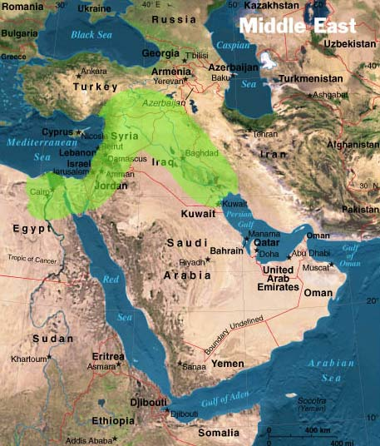
The Fertile Crescent

Slide 7
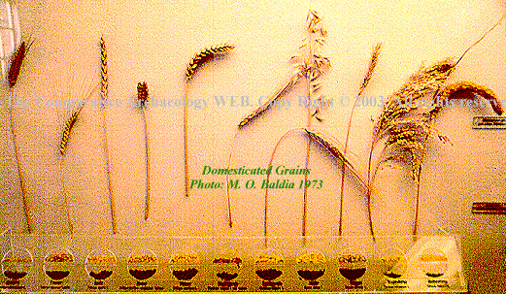
10,000 B.C. – 4000 B.C : “The Great Transition”
9500 B.C. – Fertile Crescent
  First signs of domesticated plants
    Grasses cultivated for Grains = Wheat, Barley, Rice
    Legumes cultivated for food, oil = Peas, Lentils, Beans
    Root Vegetables = yams, taro root, sweet potato
9000 B.C. – Evidence of farming
  Farming township
    Cultivated plants
      Wheat, barley, rye, lentils, chickpeas...
    Tribe still hunted gazelle
    Diet became primarily plant-based

Slide 8
10,000 B.C. – 4000 B.C : “The Great Transition”
Why Farm?
  Was NOT healthier than Hunter/Gatherer diet
  But…Farming feeds more people
    Takes 10 sq. miles to feel 1 hunter/gatherer (H/G)
    Same 10 sq. miles can feed 100+ people
  When H/Gs began to stay in one place longer…
    Population increased
    Traveled less and less
    Settlements appeared
    Thus farming began

Slide 9
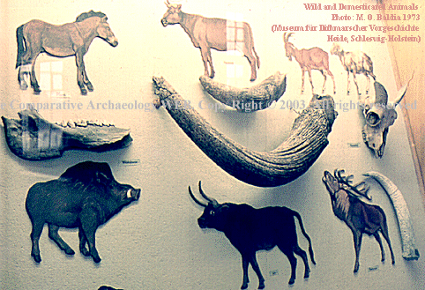
10,000 B.C. – 4000 B.C : “The Great Transition”
First Domesticated Animals:
  Approx. 10,000 B.C.
    Dogs, Pigs, Geese & Ducks
First Domesticated Livestock:
  Began in Fertile Crescent
  10,000 B.C. = Goats
  9,000 B.C. = Sheep
  6,000 B.C. = Cattle

Slide 10
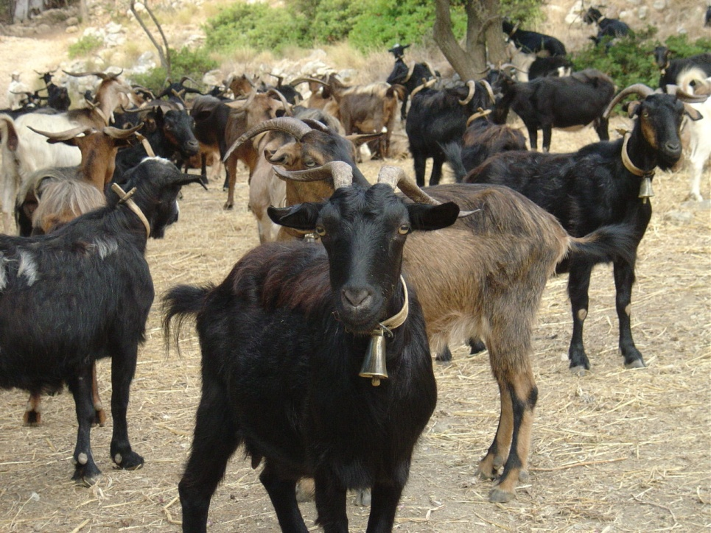
10,000 B.C. – 4000 B.C : “The Great Transition”
Why Domesticate Goats & Sheep First?
  Herbivores = cheaper to feed vs. Carnivores
  Grow quickly
  Breed in captivity
  Easy to handle
  “Gregarious”
    = live in groups
  Herding instinct
    Follow a leader

Slide 11
10,000 B.C. – 4000 B.C : “The Great Transition”
The Global Spread of Agriculture:
  Geographic expansion outward from Fertile Crescent, or…
  H/G adopting existing methods of farming, or…
  Others independently inventing their own forms of Agriculture
    Those peoples isolated geographically (S. Africa, The Americas…)
    Climatic differences in locations

Slide 12
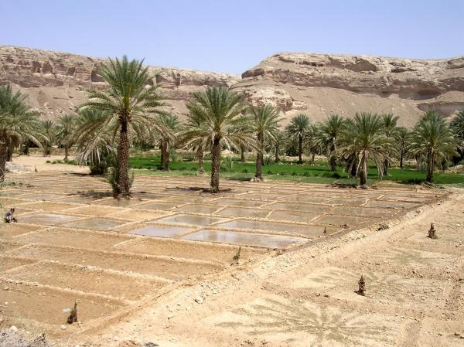
10,000 B.C. – 4000 B.C : “The Great Transition”
8000 B.C.
  Earliest evidence of farming in SW Asia
  Early domesticated plants in Andes
7000 B.C.
  Rice and Millet domesticated in China
  Evidence of gardens and drainage systems found at Kuk (Middle East)
  Farming spread to Egypt and W. India
  More evidence of domesticated sheep & goats

Slide 13
10,000 B.C. – 4000 B.C : “The Great Transition”
6000 B.C.
  Farming appears in SE Europe
  Herding/Farming in N. Africa
  Fertile Crescent
    More complex system
    Grain-based Ag integrated with livestock production
5000 B.C.
  Cereal farming (Sorghum and Millet) in N. Africa and Sahara Desert
    Farming took longer to catch on
      Different climate
      Methods and crops needed adjustment

Slide 14
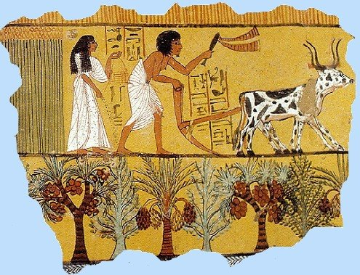
10,000 B.C. – 4000 B.C : “The Great Transition”
4000 B.C.
  Farming in N. Europe
    Expanded rapidly from Danube River basin
    Rye, Oats
  Ag arrives in Indian Subcontinent
  Earliest known remains of corn
3000 B.C.
  Rice reaches SE Asia from S China
  Egyptian Empire
    Water from the annual flooding of the Nile River is used to irrigate fields
      Allowed for development of sophisticated Ag system

Slide 15
10,000 B.C. – 4000 B.C : “The Great Transition”
2000 B.C.
  Agriculture reaches Sub-Saharan Africa
    Sorghum, yams
  The Americas:
    Cut off from rest of the world
    Had to domesticate their own crops
      Maize
      Potatoes
      Both now among most important crops in the world today
  Development of “Backed Blades”
    Would eventually lead to invention of the PLOW

Slide 16
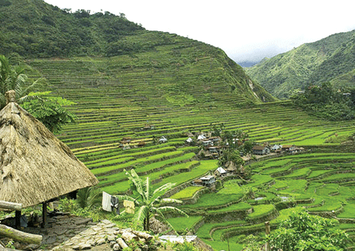
10,000 B.C. – 4000 B.C : “The Great Transition”
1000 B.C.
  Wet rice agriculture Korea & Japan
    Use of terraces to retain water
  Establishment of Ag in N. American SW
  Drained field Ag in Mexico
  Specialized Ag spread to drier climates (dryland cultivation)
    Allowed for fallow time to conserve soil moisture
  Nile Delta water control practices
  Mediterranean Ag of dry farming
    Olive/grape/fig cultivation on terraces
0 B.C./ 1 A.D.
  Hopewell culture
    First farmers in N. America

Slide 17
So What Does it All Mean?
Agriculture changed the world!
  Altered the human diet (+/-)
  Increased Food Production (+)
    Lower Quality Nutrition (-) vs. H/G
  Survival
    Successfully growing enough food to eat and exchange for other necessities of life
  Increased Population (+/-)
  Increase in Infectious Diseases (-)

Slide 18
So What Does it All Mean?? (cont.)
  Created Sedentary Lifestyle
    Non-portable artifacts
  First accumulation of “Wealth”
    Allowed for non-productive members of society
    Class system
  Led to the birth of Governments
  Has altered the Earth
    Thousands of years of cultivation has altered Earth’s surface
    Natural vegetation = rare

Slide 19
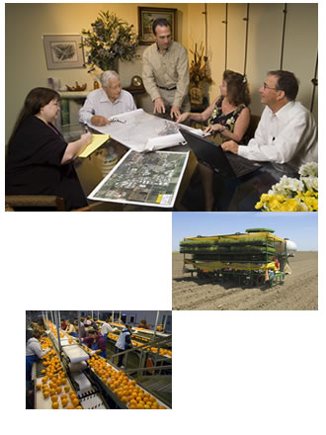
Agriculture Is…
  Not just Food Production:
  Crops grown for fiber
    Cotton
  Beverages
    Coffee, Tea
  By-Products
    Wool, Leather, Animal Pelts
  Medicines
  Agroforestry
  Misc. Products
    Rubber
  + much, much more!

Slide 20
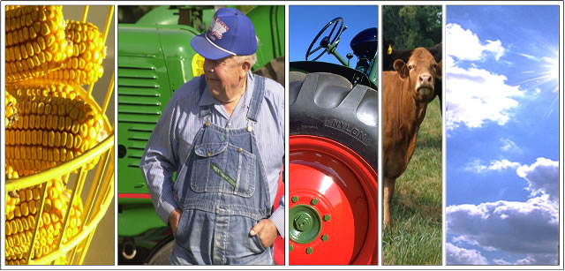
Agriculture Is…
  The Most Important economic change the world has ever seen
  The single most important occupation of people in the world
    50% of the world’s working population are employed in some form of Agriculture
  Utilizing 1,000+ species of plants and animals

Slide 21
“Changes were encouraged, not indeed to the animal’s or plant’s own good, but to man’s use or fancy…”
- Charles Darwin,
Origin of Species

